Slide 1
FEDERALISM
A system of government in which a written constitution divides the powers of government on a territorial basis between a national government and state government

Slide 2
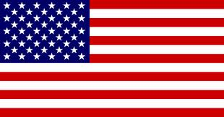
Ways to Organize Power in Federal System
Unitary
All power in the hands of the national government; state governments merely follow orders
Federal
National and state governments have real power, but national government is supreme
Confederal
Diffuses all power to state governments; national government merely keeps the states loosely bound together

Slide 3
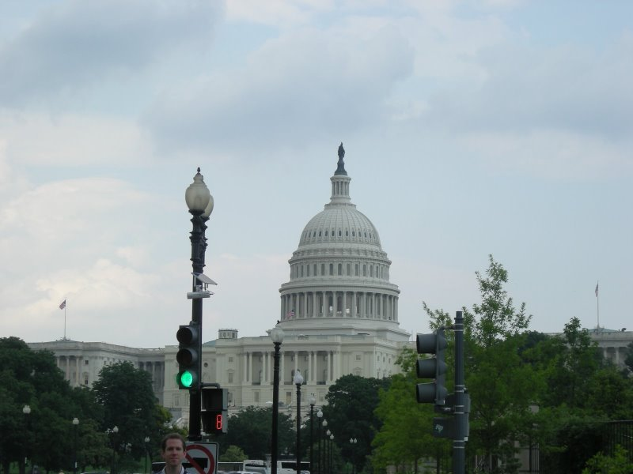
Powers of the National Government
Supremacy Clause
Article VI states that the constitution is the supreme law of the land
Expressed Powers
Powers explicitly granted to Congress
Implied Powers
Necessary and Proper; elastic clause
Inherent Powers
Preamble
Prohibited Powers
Cannot tax exports or suspend the writ of habeas corpus
Federal Powers
Coin Money
Regulate Interstate and foreign Trade
Raise and maintain the armed forces
Declare War
Govern US territories and admit new states
Conduct Foreign relations

Slide 4
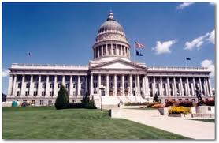
Reserved Powers
State Powers
Regulate intrastate trade
Establish public schools
Pass license requirements for professionals
Regulate alcoholic beverages
Pornography laws
Conduct elections
Establish local governments

Slide 5
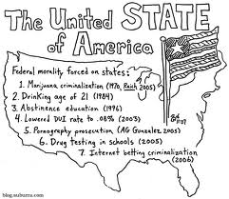
Concurrent Powers
Shared between National and State government
Levy and collect taxes
Borrow money
Establish courts
Define crime and punishments
Claim private property for public use

Slide 6
History of Federalism
Dual Federalism
1789-1945
National and State governments had their own responsibilities and they rarely overlapped
Industrialization and Globalization
As the US became a national industrial economy and businesses began to trade abroad the National government assumed a greater economic role
Cooperative Federalism
1945-1969
National and state authority became intertwined
States administer National programs and depend on national funds
New Federalism
1969-present
National government has become to powerful and power should be given back to the states

Slide 7
Mandates and Grants in Aid
Mandates
National Government orders the states to do certain things
An unfunded mandate is when the National government does not provide any money
Categorical Grants
Money given to states for a specific purpose
Restrictions usually apply
Project Grants
Money states apply for by submitting specific project proposals
Block Grants
Money given to states for fairly broad purpose with very few strings attached
Revenue Sharing
Congress gave a share of the Federal Tax Revenue to States every year
Lasted from 1972 to 1987 when President Reagan stopped the program

Slide 8
Political Cartoon Analysis

