Slide 1
IMPERIALISM
THE QUEST FOR EMPIRE

Slide 2
REASONS FOR IMPERIALISM
Imperialism is when one nation dominates another economically, politically and socially
Many viewed Imperialism as a Nation’s quest for a colonial empire.
All major nations sought to create an empire from the late 1870’s until the mid 1920’s.
The United States sought an empire for the following reasons:
Economic-we needed new markets to sell goods
Military-we needed new military bases
Humanitarian-we wanted to spread western ideas of law, government and Christianity
Nationalism-we believed we were the best and needed to compete with others to create an empire

Slide 3
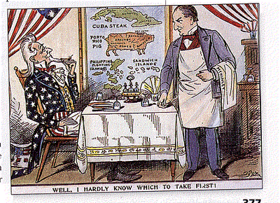
POLITICAL CARTOON ANALYSIS

Slide 4
WHY DID THE US NEED TO EXPAND?
Economically the US was growing Industrially and producing a surplus of goods. We needed new markets so people could buy our goods and to increase our access to natural resources
Alfred T. Mahan wrote a book that discussed the importance of created a strong navy to protect our borders and to protect our new colonies, in order for this to happened we needed new military bases

Slide 5
US IMPERIALISM IN THE PACIFIC
Hawaii
US annexed in 1898
Economically it had natural resources like sugar and provided a new market
Pearl Harbor provided a fueling station and a much needed naval base
Many viewed native Hawaiians as primitive and we needed to teach them Christianity
Many Native Hawaiians resented an American presence
China
The US could not trade with china in the late 1800’s because it was closed to anyone who did not have a sphere of influence
Secretary of State John Hay convinced China to open trade with everyone, this became known as the Open Door Policy
The Open Door Policy provided America with new markets and access to Natural Resources
The Boxer Rebellion began as a Chinese Nationalist movement to get rid of all foreigners

Slide 6
US IMPIERALISM IN THE PACIFIC
Japan
The nation of Japan maintained its standard of isolationism and did not trade with anyone
Commodore Matthew Perry sailed to Japan and convinced them to open trade with the US
This benefited the US by increasing our markets and access to natural resources
As a result of increased trade Japan also began to become a powerful nation in the Pacific

Slide 7
REASONS FOR US INVOLVEMENT IN THE SPANISH AMERICAN WAR
Yellow Journalism
William Randolph Hearst(and other newspaper publishers) took facts about Cuba and wrote exaggerated stories, which strengthened American sympathy for Cuban rebels
Public opinion shifted in favor of helping the Cuban rebels as a result of these stories
De Lome Letter
A Spanish ambassador wrote a letter that made fun of President McKinley and this made many Americans unhappy
USS Maine
This American ship was stationed in Havana harbor and suddenly exploded on February 15, 1898. No one knows what really happened

Slide 8
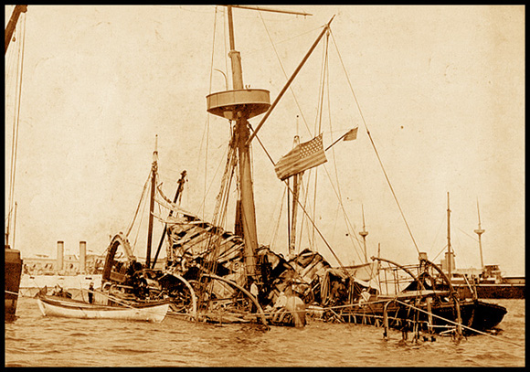
PHOTO ANALYSIS PAPER

Slide 9
MAJOR EVENTS OF THE SPANISH AMERICAN WAR
Jose Marti
Cuban National who led the initial rebellion against Spain
Valeriano Weyler
Spanish General who was very ruthless and killed many in prison camps
Teddy Roosevelt
Led the Rough Riders who charged San Juan Hill and won many battles for the US
Philippines
Admiral Dewey attacked the Spanish fleet in Manila Bay

Slide 10
OUTCOMES OF THE SPANISH AMERICAN WAR
US forced Spain to withdraw and gained control of Cuba, Puerto Rico, Guam and the Philippines
Filipino Revolt
Filipino’s resented American presence and revolted causing thousands of deaths and casualties, eventually winning their independence
Foraker Act
US would elect upper house and Puerto Ricans would elect lower house
Jones Act
Puerto Ricans are still part of US and can elect members of both houses
Platt Amendment
US took control of Cuba
Cuba could not enter into any treaty with a foreign nation
US could establish two military bases
US could intervene in Cuban diplomacy whenever
Many Cuban’s resented America as a result
As a result of this resentment this opened the door for Fidel Castro to lead a communist revolution in Cuba

Slide 11
US IMPERIALISM IN LATIN AMERICA
Latin America had a wealth of natural resources and many consumers
Panama Canal
President Roosevelt signed the Huay-Bunau-Varilla Treaty that gave the US control of a 10 mile piece of land to build a canal across the isthmus of Panama
Allowed for ships to get from the Atlantic to the Pacific much faster
Very difficult process and many died
Banana Republics
Latin American nations where American fruit companies established factories for cheap labor
Dollar Diplomacy
President Taft’s policy to use economic pressure instead of the military to create stability in Latin America
US gave loans and resources, but did not get a good return on our investment
President Wilson
Believed that the US should promote democracy in Latin America, use force only if necessary.
If everyone was a democracy then we would work together
Mexico
Pancho Villa was fighting against the US and to unite Mexico
US and Mexican relations tough

Slide 12
MONROE DOCTRINE AND ROOSEVELT COROLLARY
Monroe Doctrine
In 1823 President Monroe issued a state that said “European nations should not seek colonial claims in the Western Hemisphere”
President Monroe was hoping that Europe would stay away and then we would not get involved in conflict
Roosevelt Corollary
President Roosevelt’s Foreign Policy idea was to “speak softly and carry a big stick”
He issued a statement in the early 1900’s that said “the US will intervene and police the Western Hemisphere”

Slide 13
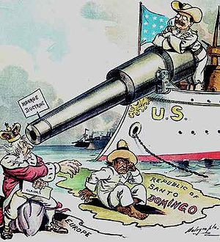
POLITICAL CARTOON ANALYSIS

Slide 14
ANTI-IMPERIALISM IDEAS
President Washington
In his farewell address he advised America to avoid alliances and political parties
Arguments against Imperialism
Political-US should remain isolationist, not get involved in other peoples problems
Racial-imposing our ideals on others is inherently racist
Economic-Cost too much to expand and creates competition for jobs

