Slide 1
VIETNAM IMAGES
COMPLETE A PHOTO ANALYSIS FOR EACH PHOTO AND THE CARTOON ANALYSIS

Slide 2
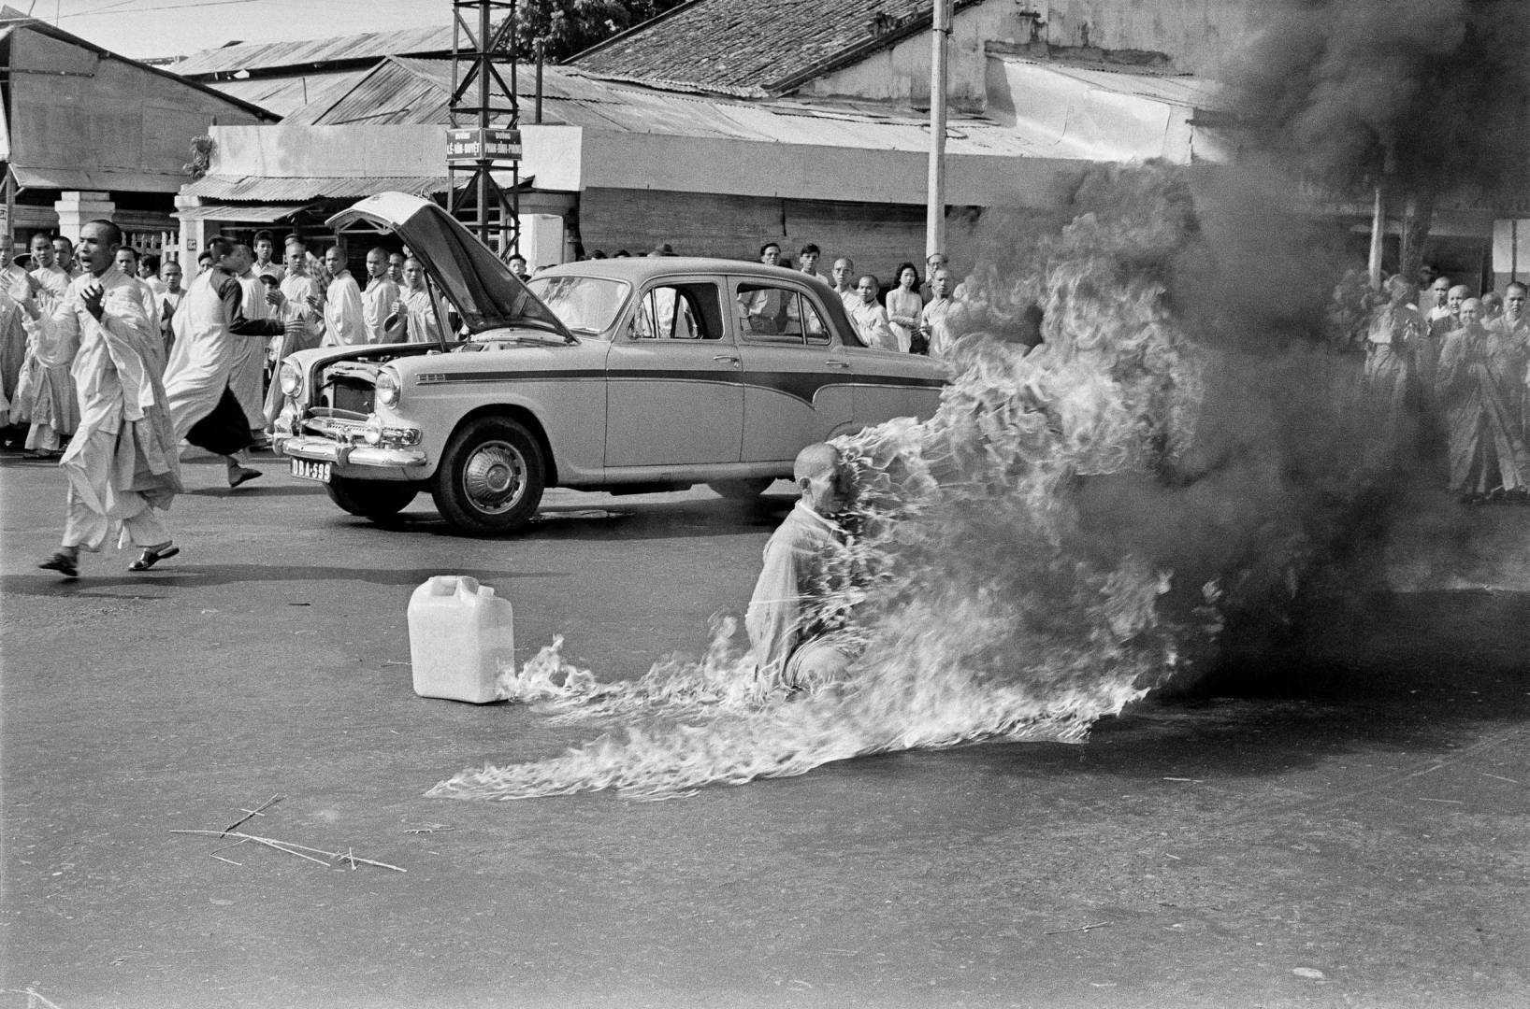
Notes:
Associated Press, June 1963

Slide 3
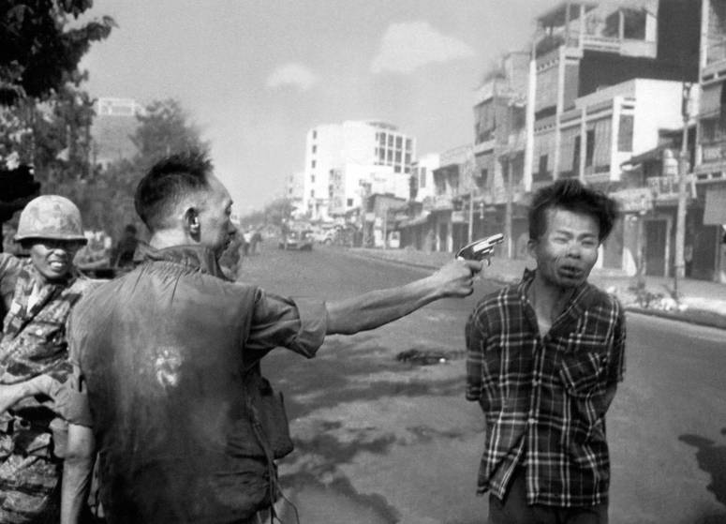
Notes:
Associated Press February 1968

Slide 4
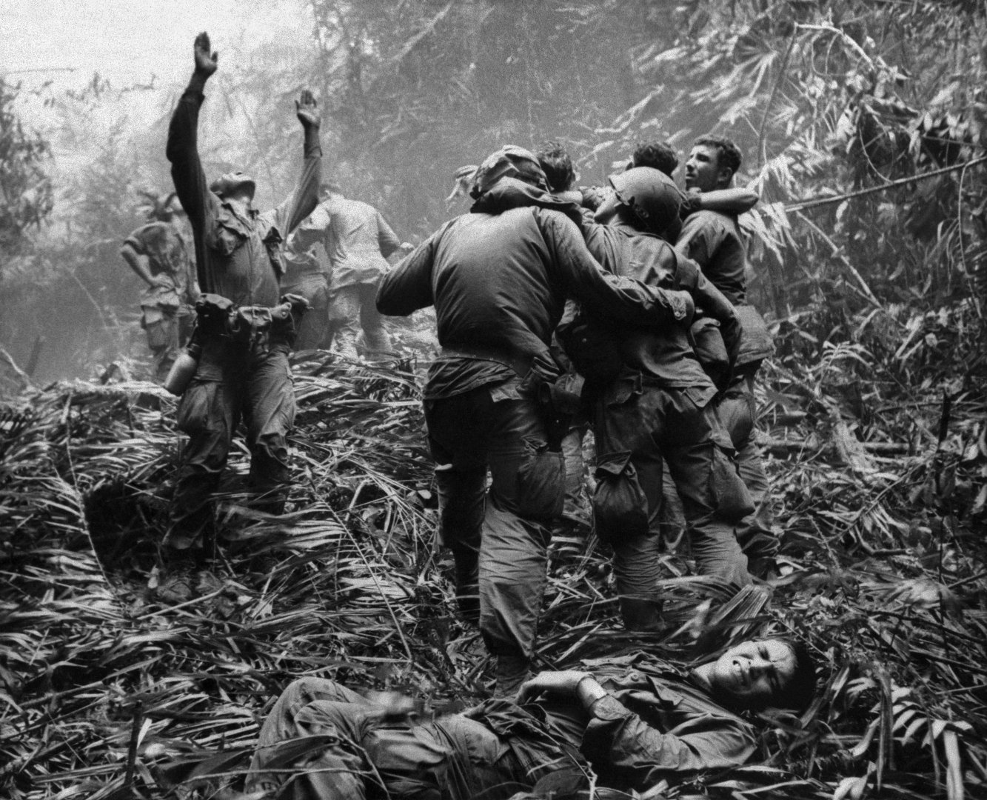
Notes:
Washington Post 1968

Slide 5
